Slide 1
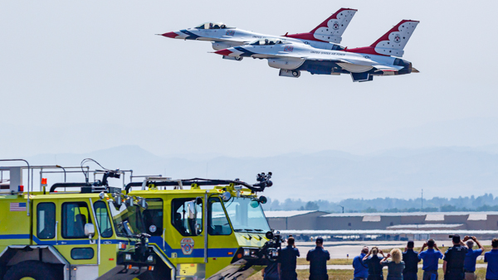

Runway Widening Construction Meeting
August 19th, 2026

Slide 2
Agenda
Safety and Security
Construction Progress
Important Dates
Open Discussion

Slide 3
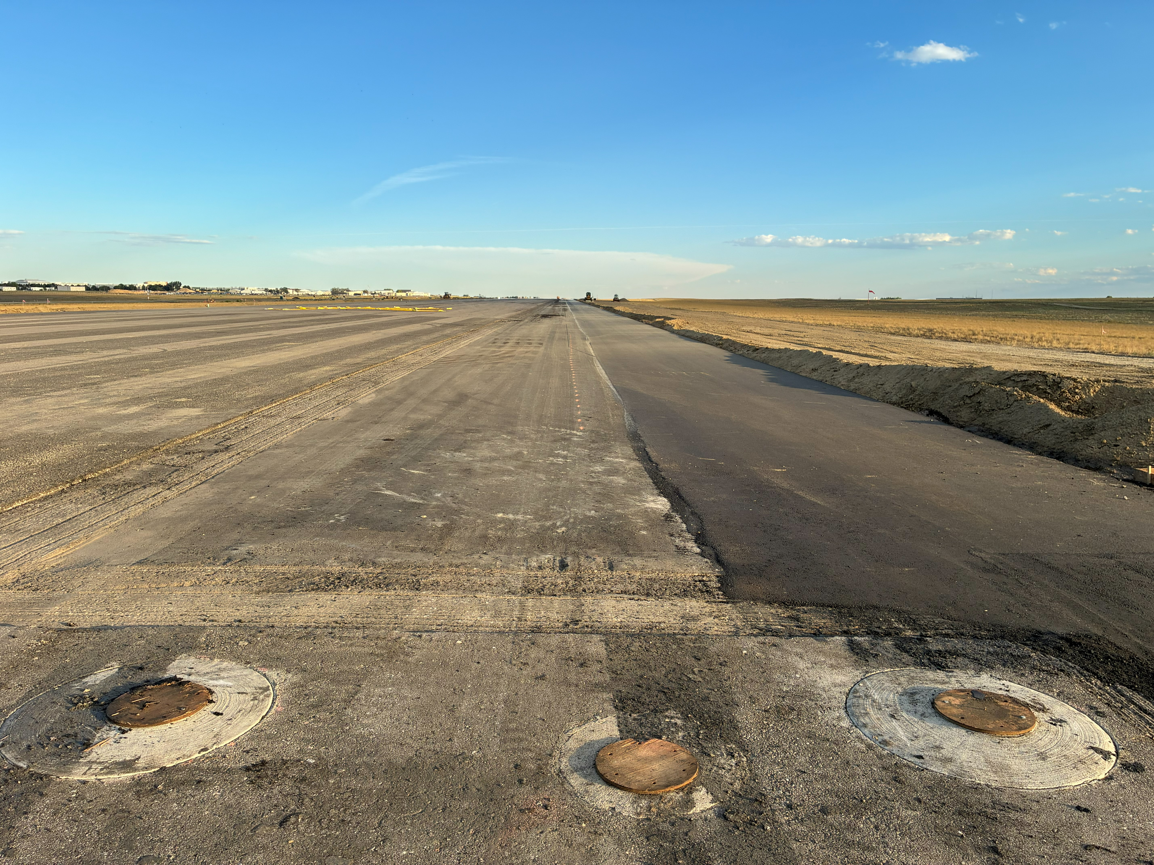
Safety and Security
West Edge
Please report all concerns as soon as practical to airport operations
Continue to check NOTAMs for the most up-to date information: Filter 30+ days
3

Slide 4
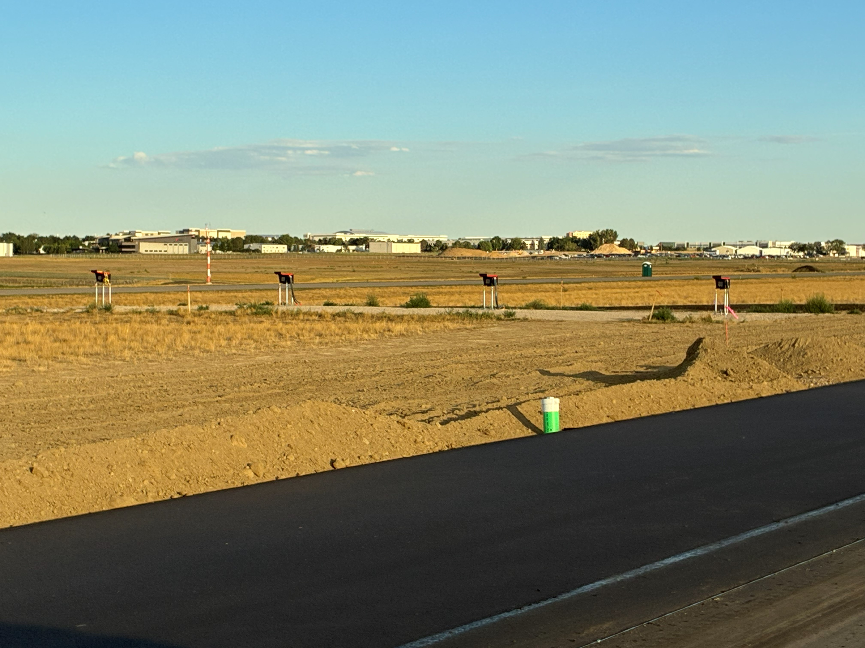
Construction Progress
15 PAPIs
Project is on schedule
Up-to-date construction information at
www.flynoco.com/fnl-runway-15-33-widening-project/
4
Notes:
Phase 1 will encompass the north section of Runway 15/33: Call out Aircraft operational aeras, movement aeras, conflicts with Construction equipment

Slide 5
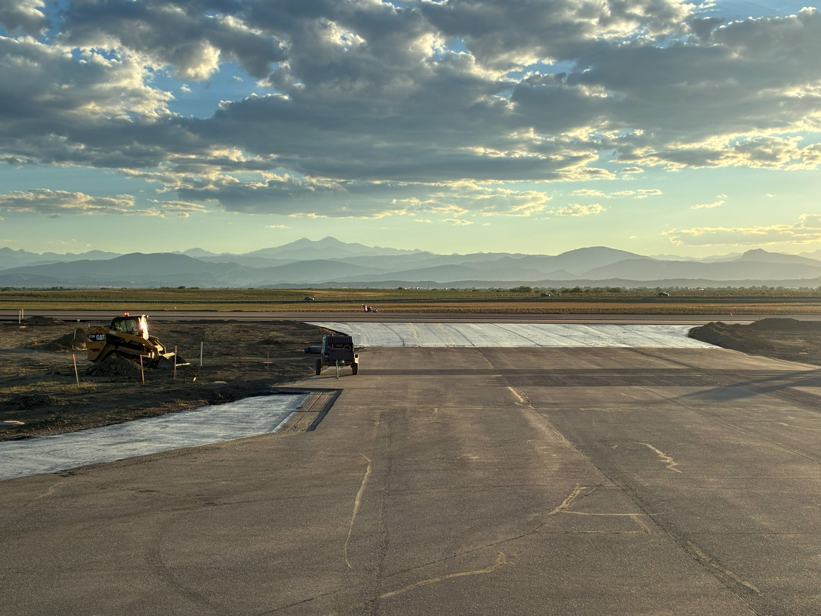
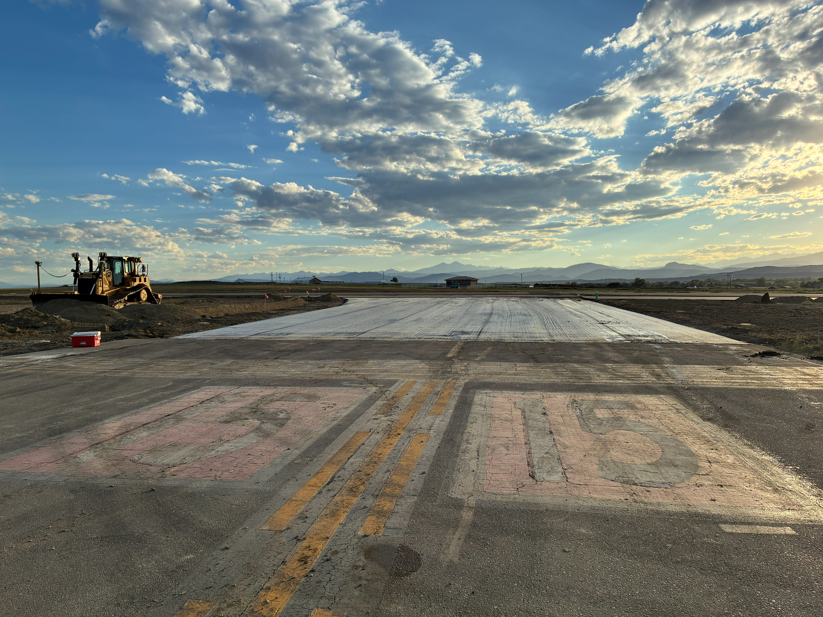
TWY A4
TWY A5

Slide 6
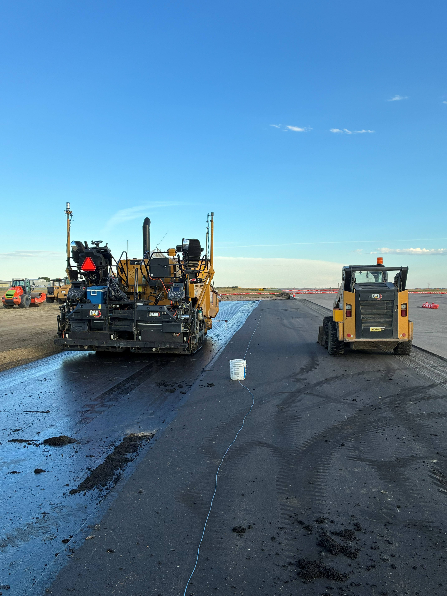
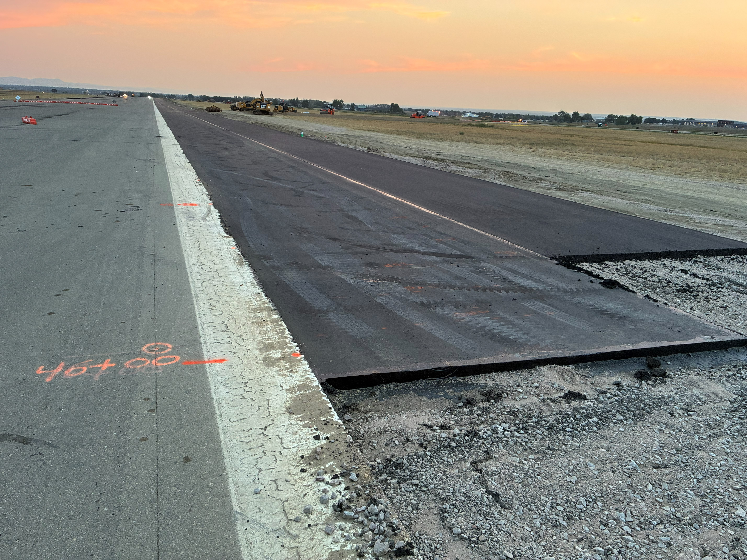
East Edge

Slide 7
Important Dates
August 25th & 26th – On Schedule for Full Airport Closure
  All Runways and Alpha Taxiways (A, A1, A2, A3, A4, A5)
  ^{Transition Phase 1 to Phase 2}
TBD during Phase 2 - Full RWY Closure
  Crack sealing North Rwy 15-33 & Twy A, A4, A5,

Slide 8
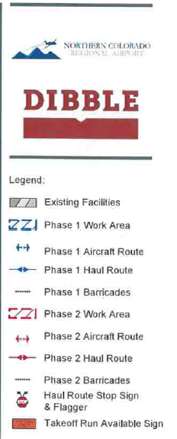
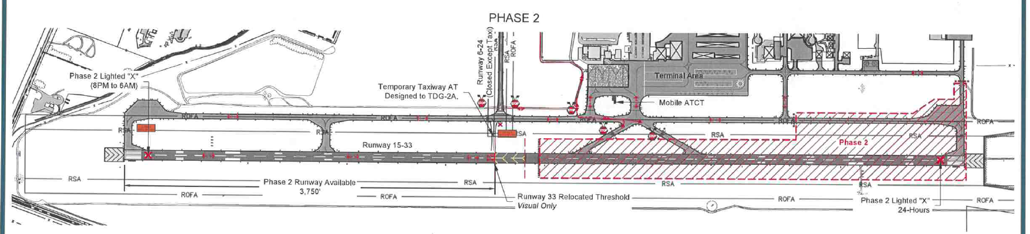
Phase 2

Slide 9
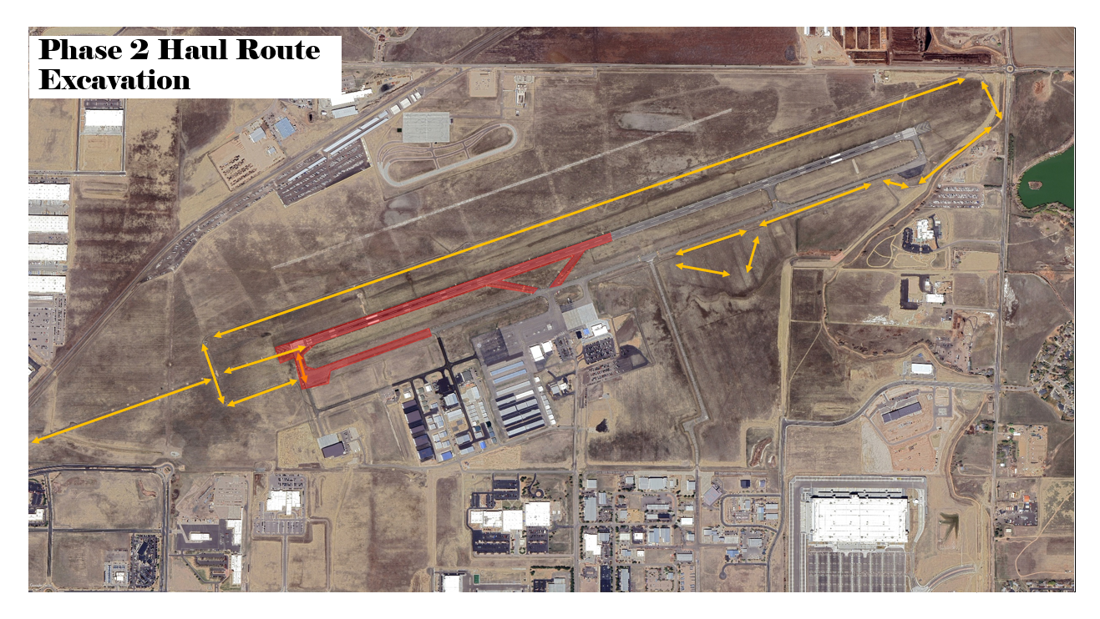

Slide 10
www.flyFNL.com

