Slide 1
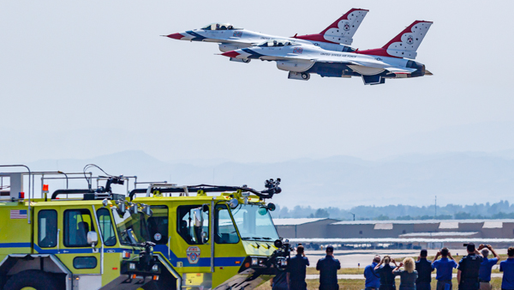

Runway Widening Construction Meeting
September 2, 2026

Slide 2
Agenda
Safety and Security
Construction Progress
Important Dates
Open Discussion

Slide 3
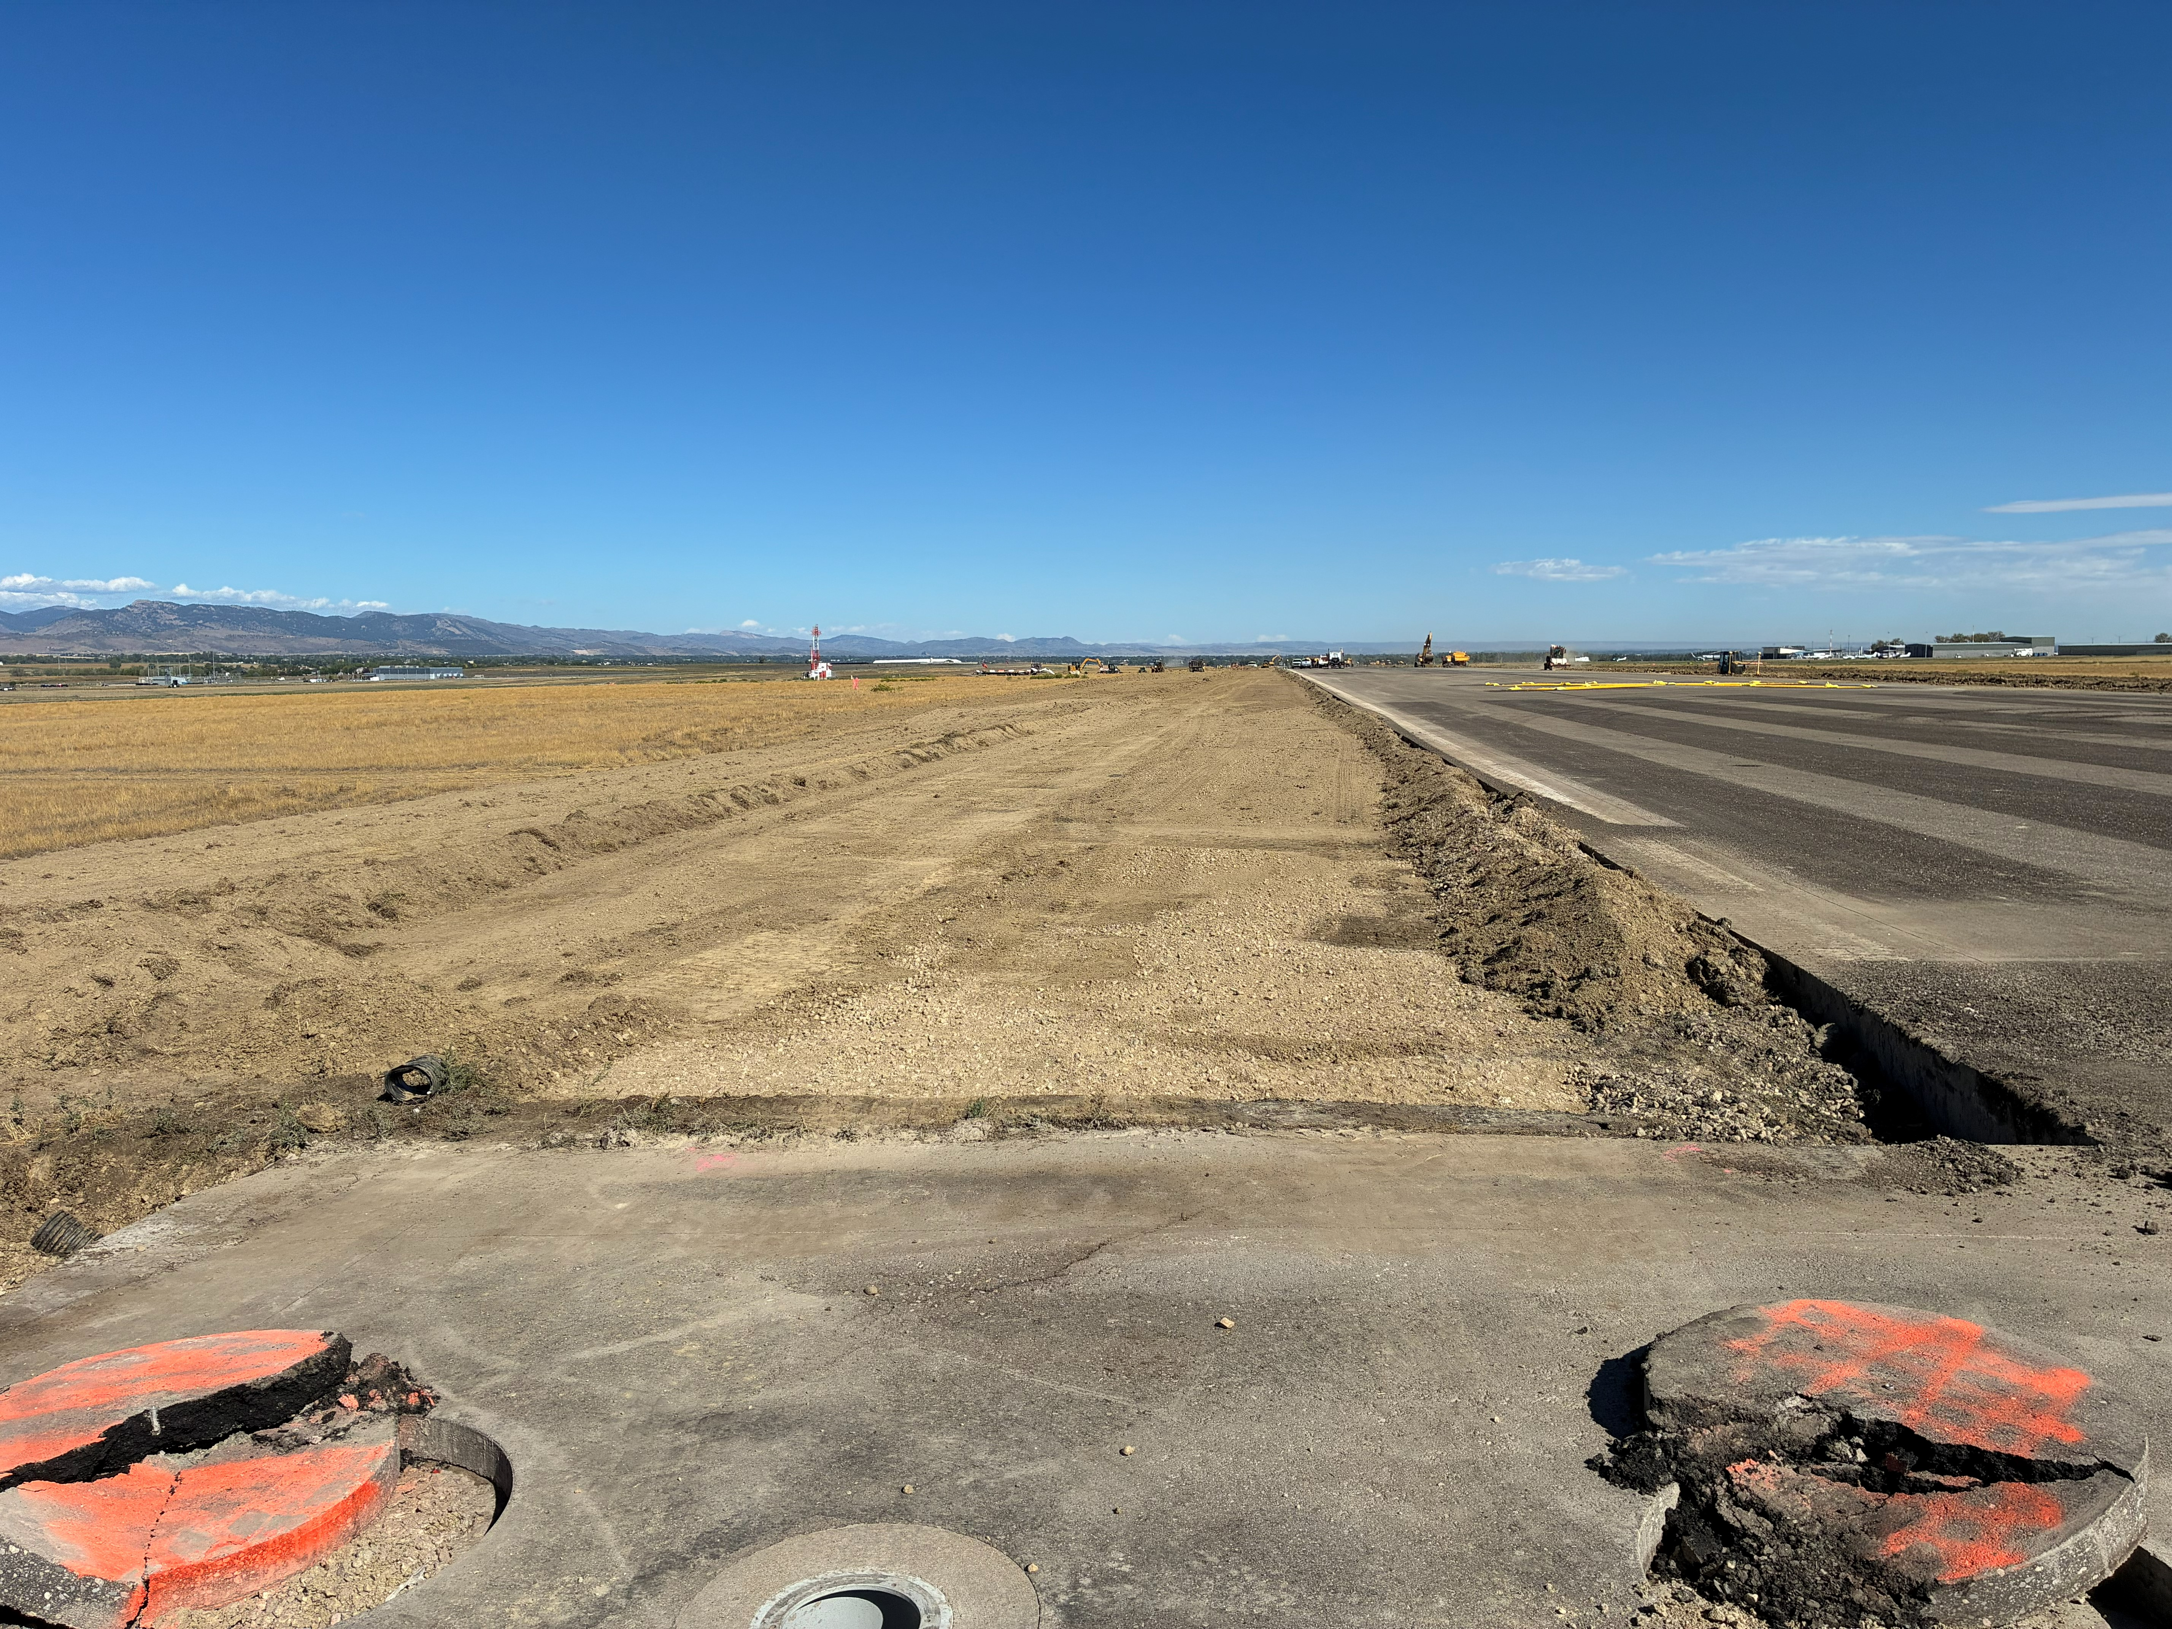
Safety and Security
West Edge
Please report all concerns as soon as practical to airport operations
Continue to check NOTAMs for the most up-to date information: Filter 30+ days
  NOTAM TWY AT - PERM
3

Slide 4
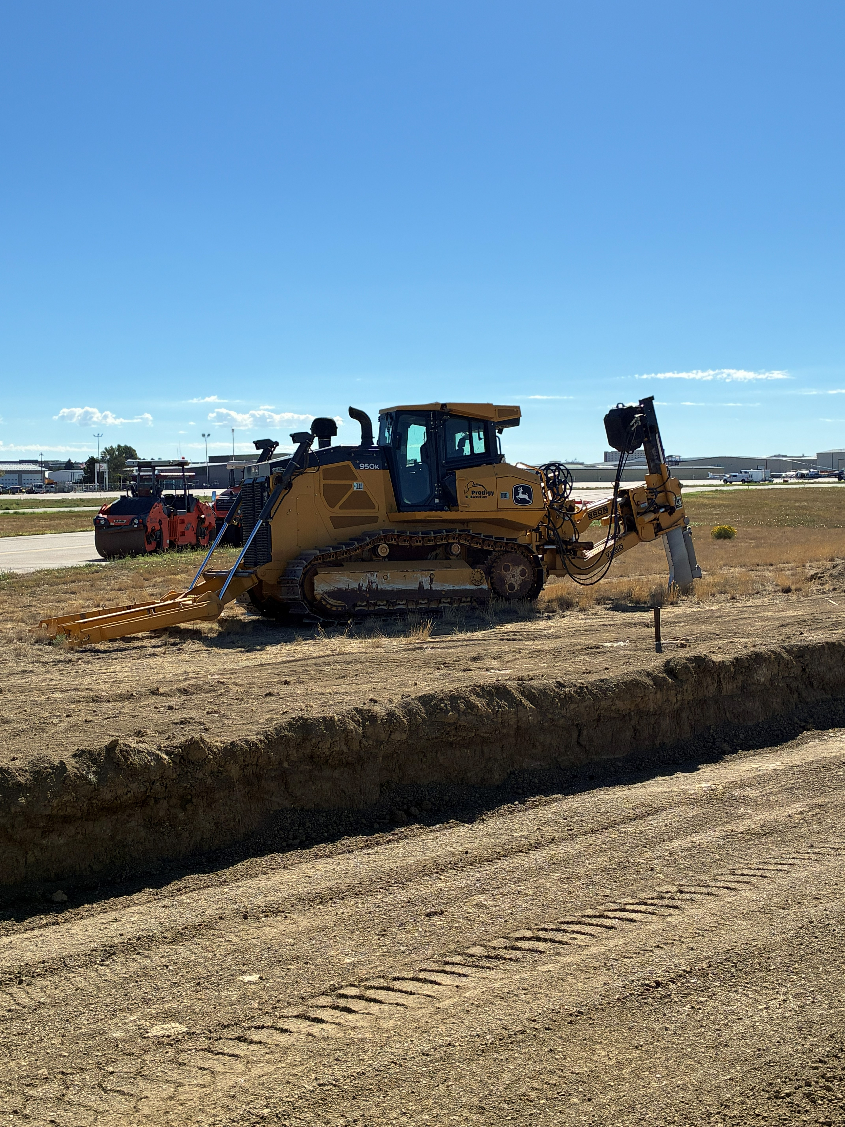
Construction Progress
Project is on schedule
Up-to-date construction information at
www.flynoco.com/fnl-runway-15-33-widening-project/
4
Notes:
Phase 1 will encompass the north section of Runway 15/33: Call out Aircraft operational aeras, movement aeras, conflicts with Construction equipment

Slide 5
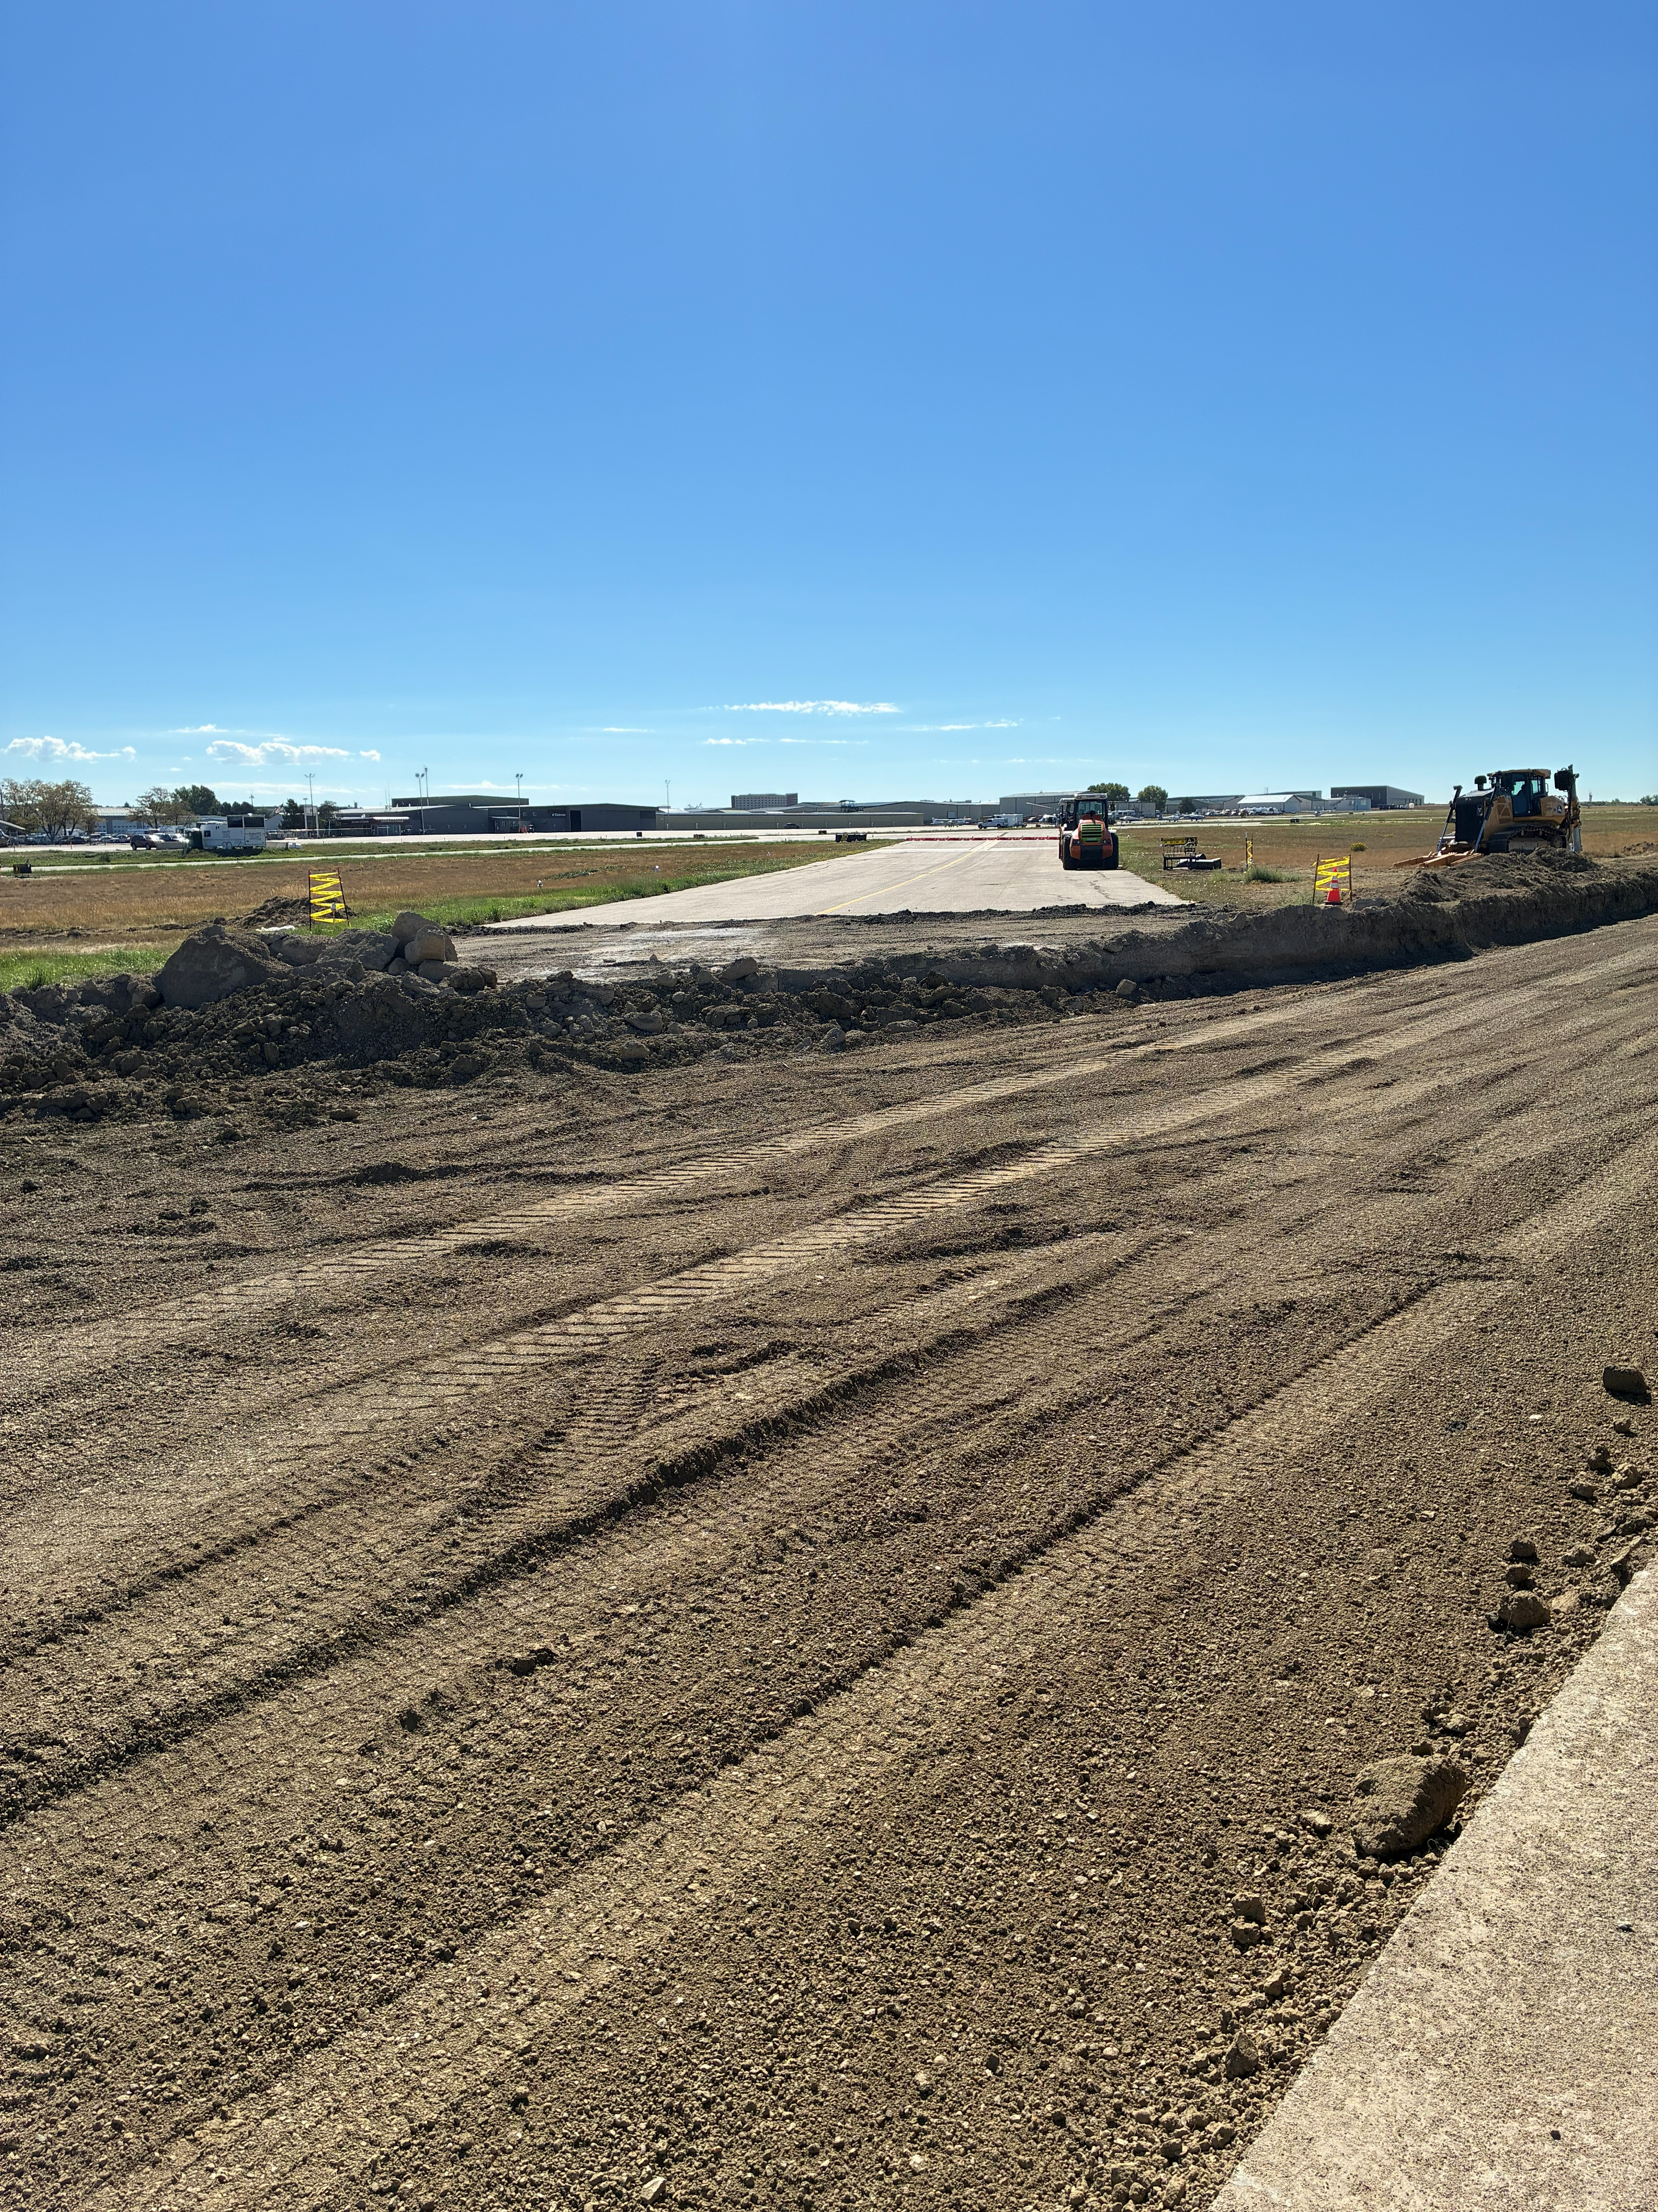
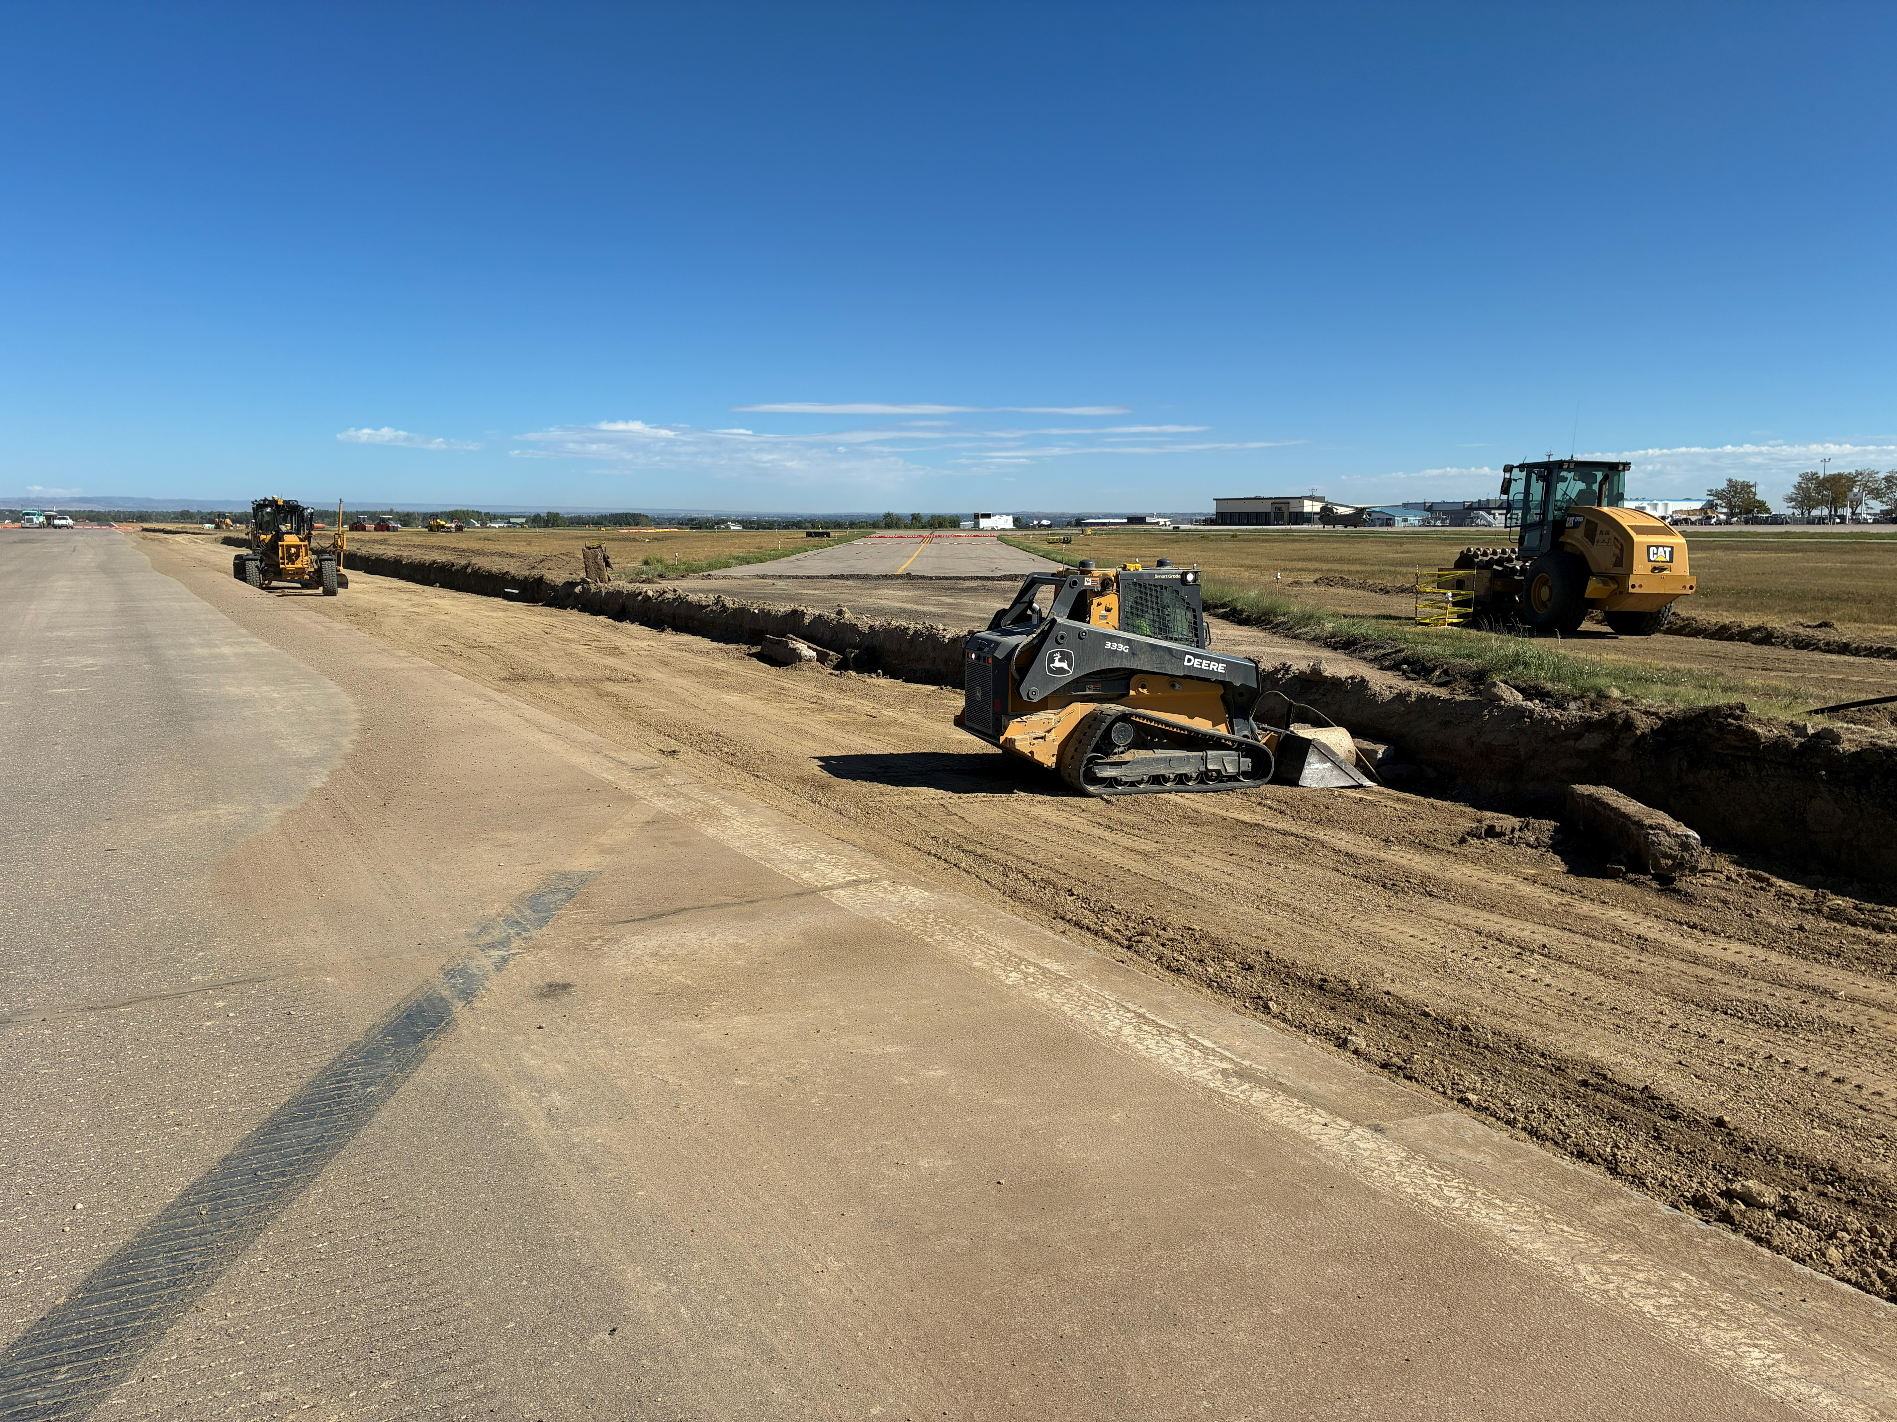
TWY A3
TWY A2

Slide 6
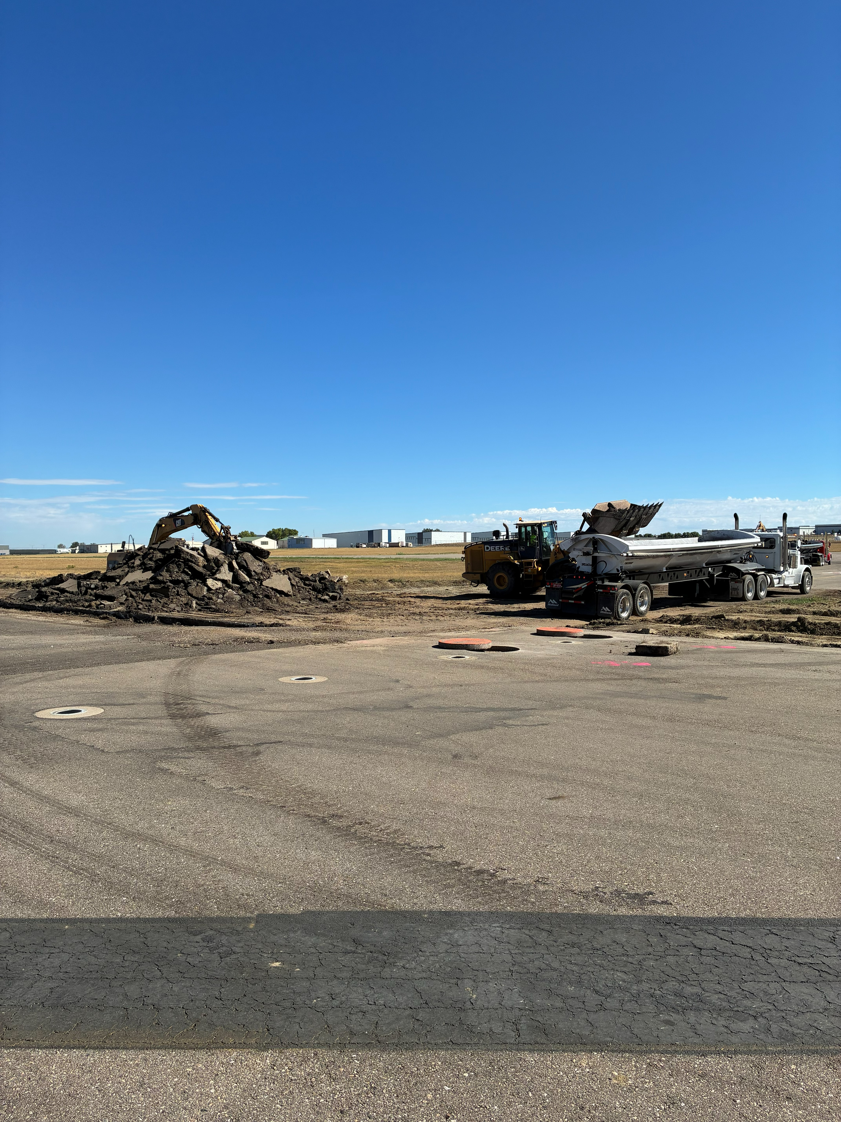
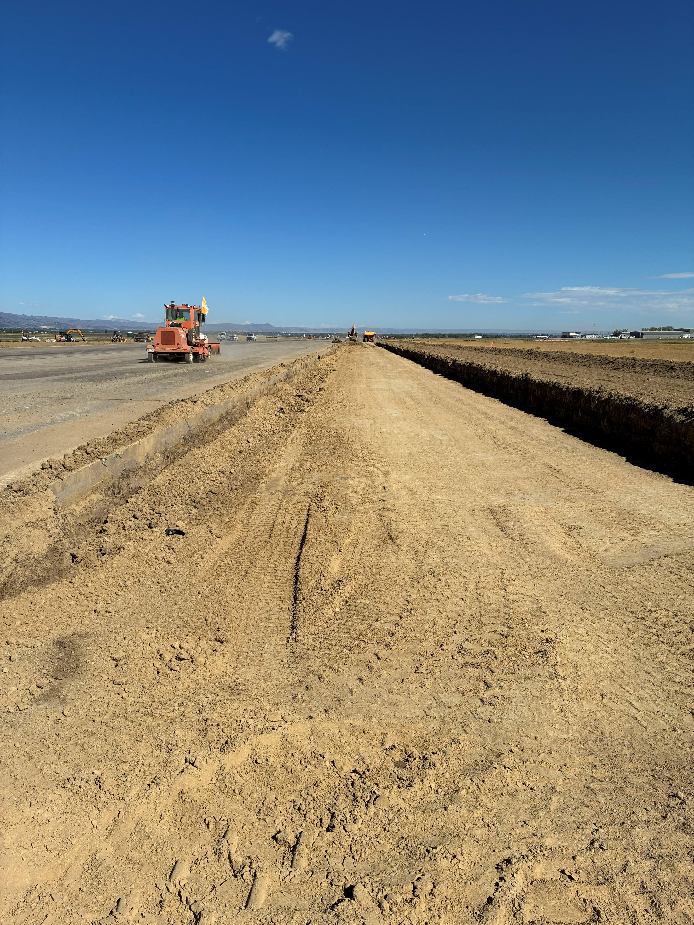
TWY A1
East Edge

Slide 7
Important Dates
  ^{Sept 9th - Full RWY Closure}
  Crack sealing North section Rwy 15-33 & Twy A, A4, A5
  Sept 10th alternate date in case of weather
  ^{Extended Tower Hours:}
  ^{Sept 4th till 23:59}

Slide 8
www.flyFNL.com

